Slide 1
A Comparison of Document Clustering Techniques
By Michael Steinbach(University of Minnesota, total citation 21079), et al. KDD workshop on text mining (Vol. 400, No. 1, pp. 525-526),2000. Citation: 2891
Presenter: Yue Shi.
yueshi@usc.edu
Notes:
Slides can vary as per your presentation, but header and footer should be consistent

Slide 2
Presentation organization
Background. 2
Clustering algorithms 7
Evaluation metrics 12
Dataset 16
Experiment results 18
Explanation 21
Conclusion 22
Pros and Cons 23

Slide 3
Background: What is document clustering?
Assign documents to different topics or topic hierarchies
Notes:
As opposed to document classfication, which is a supervised classfication

Slide 4
Background: Why need document clustering
Automatic hierarchical document organization.
Topic extraction
Fast information retrieval.
Improve information retrieval precision and recall
Notes:
discovering meaningful implicit subjects across all documents

Slide 5
Background: Clustering techniques
Hierarchical clustering:
Single link, complete linkage, group average [1] and Ward’s method[2]
Partitional clustering:
K-means clustering and its variants, e.g. bisecting k-means(first time used in this paper).
Graph based document clustering [4,MS Hossain,2007]
Ontology based document clustering [5, A Hotho 2002]
Notes:
at each step combining two clusters that contain the closest pair of elements not yet belonging to the same cluster as each other.

Slide 6
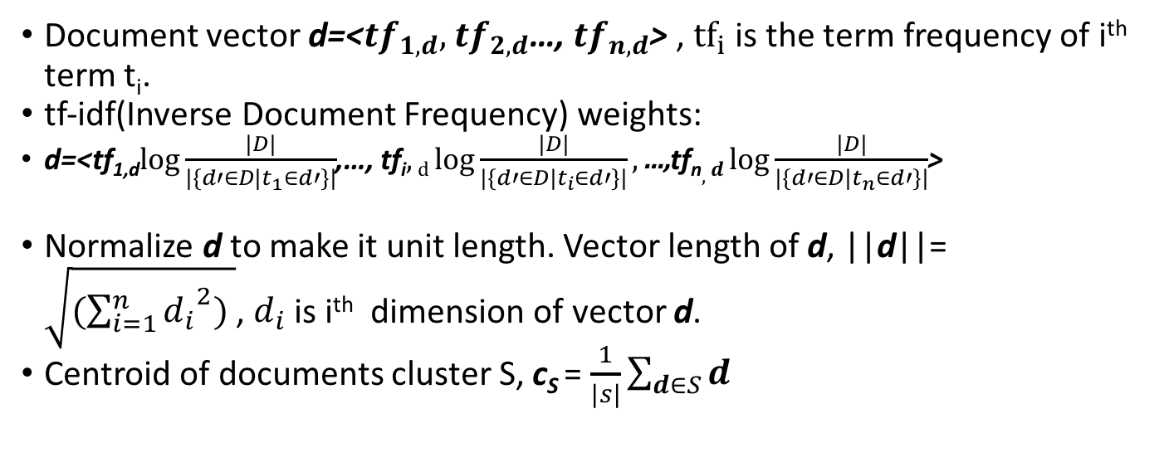
Background: Document Representation
Document vector d=<${tf}_{1,d},$ ${tf}_{2,d}$…, ${tf}_{n,d}$> , ${tf}_{i}$ is the term frequency of i^{th} term t_{i}.
tf-idf(Inverse Document Frequency) weights:
d=<tf_{1,d}$\log{\frac{|D|}{|\{d′∈D|t_{1}∈d′\}|}}$,…, tf_{i}$,d\log{\frac{|D|}{|\{d′∈D|t_{i}∈d′\}|}},\text{...,}\text{tf}\text{n},d\log{\frac{|D|}{|\{d′∈D|t_{n}∈d′\}|}}$>
Normalize d to make it unit length. Vector length of d, ||d||= $\sqrt{(\sum_{i=1}^{n}{{d_{i}}^{2}}) }$, $d_{i}$ is i^{th} dimension of vector d.
Centroid of documents cluster S, c_{S} = $\frac{1}{|s|}\sum_{d∈S}{d}$

Slide 7
Clustering techniques compared in this paper
Hierarchical clustering:
Bottom-up approach: agglomerative
Partitional clustering:
K-means clustering and its variant: bisect k-mean clustering

Slide 8
Agglomerative hierarchical clustering algorithm
Each single point is initialized as a cluster, calculate the similarity matrix of all pairs of clusters.
Merge the two closest clusters as a single cluster
Update the similarity matrix.
Repeat the above 2 steps until a single cluster remains.
p1
p4
c2
c1
p2
p3
Centroid cluster similarity and Euclidean distance
O(n³) time complexity and O(n²) space complexity

Slide 9
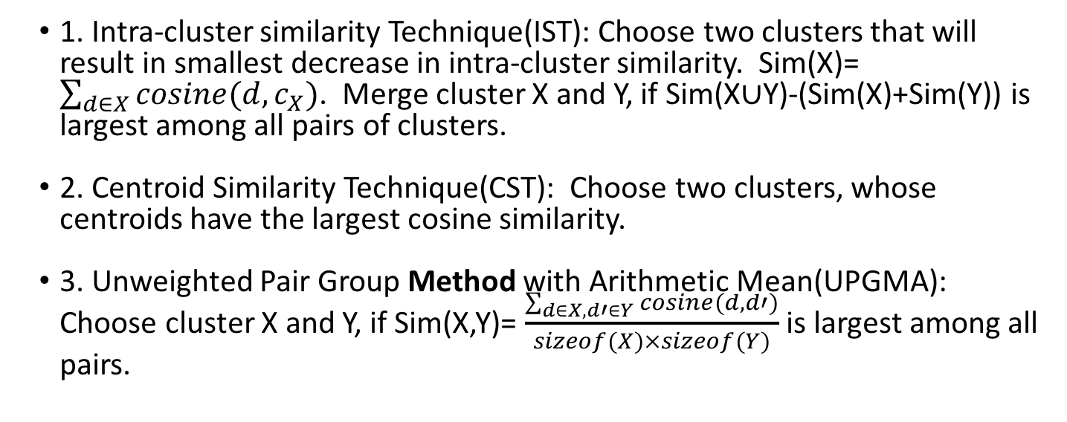
How to choose two closest clusters?
1. Intra-cluster similarity Technique(IST): Choose two clusters that will result in smallest decrease in intra-cluster similarity. Sim(X)= $\sum_{d∈X}{cosine(d,c_{X})}$. Merge cluster X and Y, if Sim(X$∪$Y)-(Sim(X)+Sim(Y)) is largest among all pairs of clusters.
2. Centroid Similarity Technique(CST): Choose two clusters, whose centroids have the largest cosine similarity.
3. Unweighted Pair Group Method with Arithmetic Mean(UPGMA): Choose cluster X and Y, if Sim(X,Y)= $\frac{\sum_{d∈X, d′∈Y}{cosine(d,d′)}}{sizeof(X)×sizeof(Y)}$ is largest among all pairs.
Notes:
Unweighted Pair Group Method with Arithmetic Mean

Slide 10
K-means clustering algorithm
Select K initial centroids
Calculate the similarity of each point to all the centroids, assign the point to its closest centroid
Re-calculate the centroid of each cluster
Repeat the above two steps until no changes are made.
Time complexity: O(mn), m is the number of iterations until convergency

Slide 11
Bisect K-means algorithm
Pick a cluster to split. (How? 1. largest cluster 2. least overall similarity 3.both)
Using basic 2-means to generate two sub-clusters
Repeat the above step for ITER times, pick the splitting that generates the highest overall clustering similarity
Repeat the above 3 steps until reaching the expected number of clusters.

Slide 12
Quality Evaluation
Entropy
F-measure
Overall similarity

Slide 13
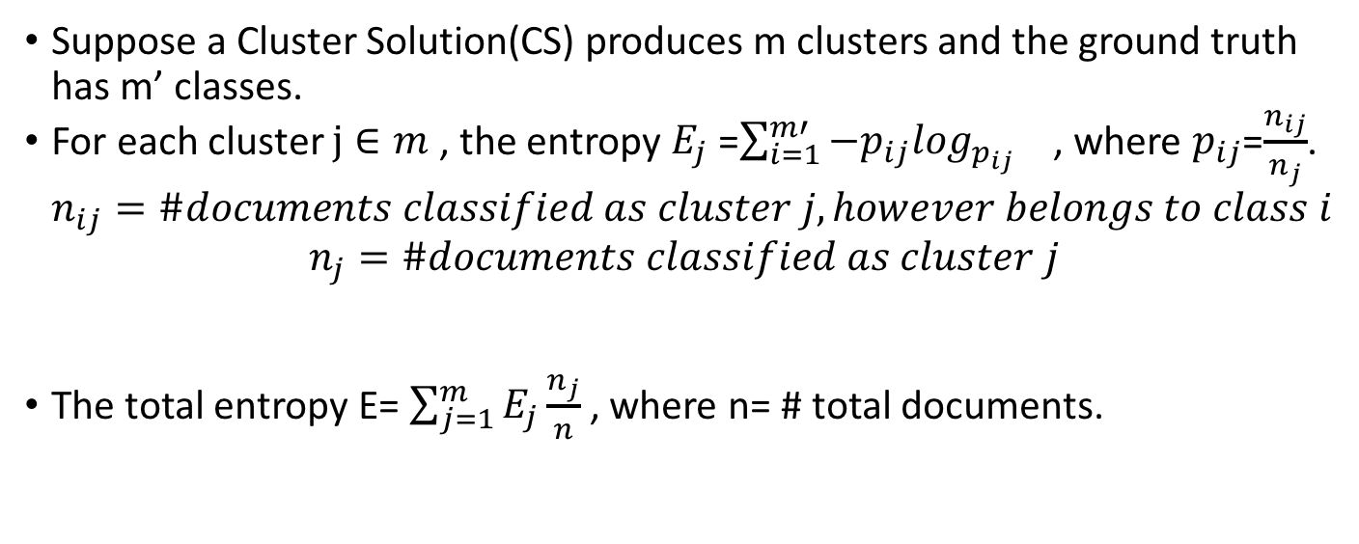
Quality Evaluation: Entropy
Suppose a Cluster Solution(CS) produces m clusters and the ground truth has m’ classes.
For each cluster $j∈m$ , the entropy $E_{j}$ =$\sum_{i=1}^{m′}{−p_{ij}\log_{p_{ij}}}$ , where $p_{ij}$=$\frac{n_{ij}}{n_{j}}$. $n_{ij}=\#documents classified as cluster j, however belongs to class i$
$$n_{j}=\#documents classified as cluster j$$
The total entropy E= $\sum_{j=1}^{m}{E_{j}\frac{n_{j}}{n}}$ , where n= # total documents.

Slide 14
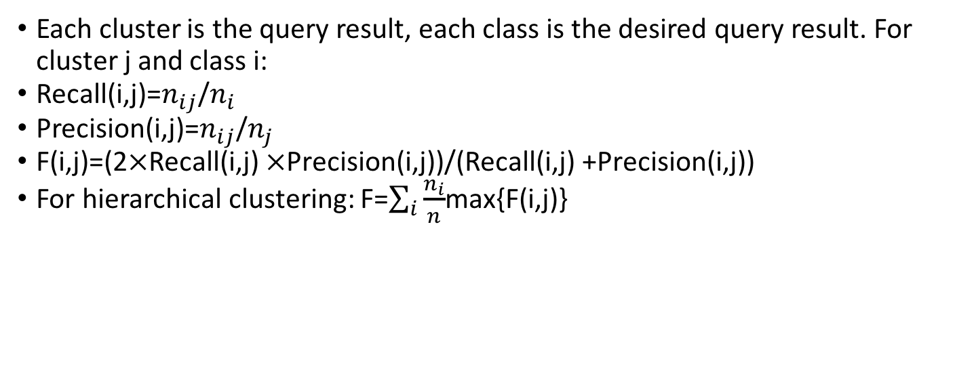
Quality Evaluation: F-measure
Each cluster is the query result, each class is the desired query result. For cluster j and class i:
Recall(i,j)=$n_{ij}$/$n_{i}$
Precision(i,j)=$n_{ij}$/$n_{j}$
F(i,j)=(2$×$Recall(i,j) $×\text{Precision}\text{(}\text{i}\text{,}\text{j}\text{)}$)/(Recall(i,j) +$\text{Precision}\text{(}\text{i}\text{,}\text{j}\text{)}$)
For hierarchical clustering: F=$\sum_{i}{\frac{n_{i}}{n}}$max{F(i,j)}

Slide 15
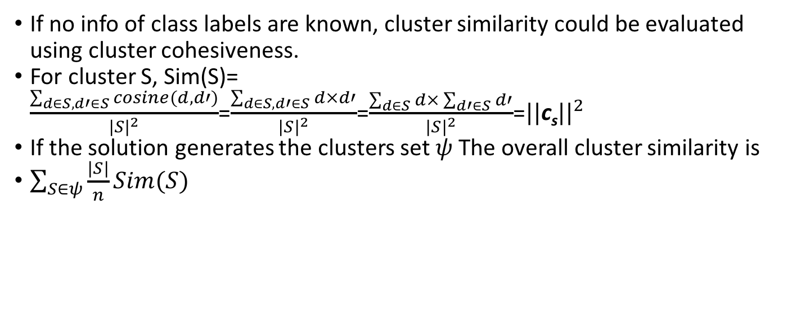
Quality Evaluation: Overall similarity
If no info of class labels are known, cluster similarity could be evaluated using cluster cohesiveness.
For cluster S, Sim(S)= $\frac{\sum_{d∈S, d′∈S}{cosine(d,d′)}}{{|S|}^{2}}$=$\frac{\sum_{d∈S, d′∈S}{d×d′}}{{|S|}^{2}}$=$\frac{\sum_{d∈S}{d×\sum_{d′∈S}{d′}}}{{|S|}^{2}}$=${||\text{c}\text{s}||}^{2}$
If the solution generates the clusters set $ψ$ The overall cluster similarity is
$\sum_{S∈ψ}{\frac{|S|}{n}Sim(S)}$

Slide 16
Dataset
Re0,re1: Reuters-21578. (https://archive.ics.uci.edu/ml/datasets/reuters-21578+text+categorization+collection )
Wap: WebACE Project(Yahoo!)
Rest: Trec(http://trec.nist.gov/data.html )
Notes:
each document corresponds to a web page listed in the subject hierarchy of Yahoo

Slide 17
Dataset Preprocessing
Remove stop words, e.g. Common words like “the”, “do”, etc.
Suffix-stripping, i.e. same stem=> same words. “doing”, “did”, “does”=> do

Slide 18
Experiment Results
1. Hierarchical clustering with 3 similarity calculation methods.
2. Comparison of hierarchical clustering, k-means, bisecting k-means.

Slide 19
Experiment Results
Hierarchical algorithms with 3 clustering similarity: IST, CST and UPGMA:
F-measure: For all datasets, UPGMA better than IST and CST.
Entropy:
UPGMA and IST better than CST .
In some datasets, initially CST as good as UPGMA and IST, but making more misclassifications later. In other datasets, CST behaves worst from the beginning.
For dataset tr31, la1 and la2, whose number of classes are small, UPGMA also starts making more misclassifications at some points.

Slide 20
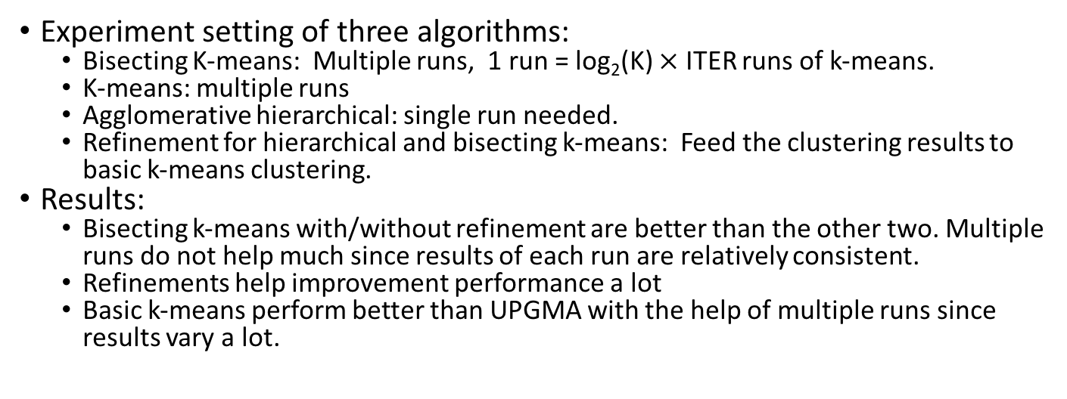
Comparison of hierarchical clustering, k-means, bisecting k-means.
Experiment setting of three algorithms:
Bisecting K-means: Multiple runs, 1 run = log₂(K) $×$ ITER runs of k-means.
K-means: multiple runs
Agglomerative hierarchical: single run needed.
Refinement for hierarchical and bisecting k-means: Feed the clustering results to basic k-means clustering.
Results:
Bisecting k-means with/without refinement are better than the other two. Multiple runs do not help much since results of each run are relatively consistent.
Refinements help improvement performance a lot
Basic k-means perform better than UPGMA with the help of multiple runs since results vary a lot.

Slide 21
Explanation of experiment results
Why agglomerative hierarchical clustering performs bad?
With vector space representation, documents’ nearest neighbor(with highest similarity) may not belong to the same class as itself.
K-means make use of average similarity of cluster documents.
Why bisecting k-means better than k-means?
Bisecting k-means tends to produce relatively similar size of purer clusters.

Slide 22
Conclusions
Bisecting k-means consistently better than basic k-means , and in most cases better than agglomerative hierarchical clustering with the 8 test datasets as regards to overall similarity and entropy.
Run time: bisecting k-means linear to document numbers, while hierarchical quadratic to that.
Reasons of different results than other researchers:
Multiple runs of basic k-means
First time to use bisecting k-means
Document properties affect the results

Slide 23
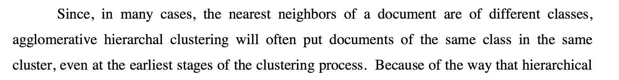
Pros and Cons
Pros:
Detailed instructions on experiment setting for readers to repeat the experiment.
Good visualization of experiment results and table summary.
Cons:
How different dataset properties affect performance of algorithms?
Minor typos:
different

Slide 24
References
[1] https://nlp.stanford.edu/IR-book/completelink.html
[2]Ward, J. H., Jr. (1963), "Hierarchical Grouping to Optimize an Objective Function", Journal of the American Statistical Association, 58, 236–244.
[3] Deerwester, S., et al, Improving Information Retrieval with Latent Semantic Indexing, Proceedings of the 51st Annual Meeting of the American Society for Information Science 25, 1988, pp. 36–40.
[4] Hossain, M. Shahriar, and Rafal A. Angryk. "Gdclust: A graph-based document clustering technique." Data Mining Workshops, 2007. ICDM Workshops 2007. Seventh IEEE International Conference on. IEEE, 2007.
[5] Hotho, Andreas, Alexander Maedche, and Steffen Staab. "Ontology-based text document clustering." KI 16.4 (2002): 48-54.

Slide 25
Questions?? THANK YOU!!!

